Slide 1


Dream Builders

Slide 2
Agenda
Who are we / team introductions
Who are we working for and why?
Partner organization and why we are passionate to help them
Stakeholder Register
Q&A

Slide 3
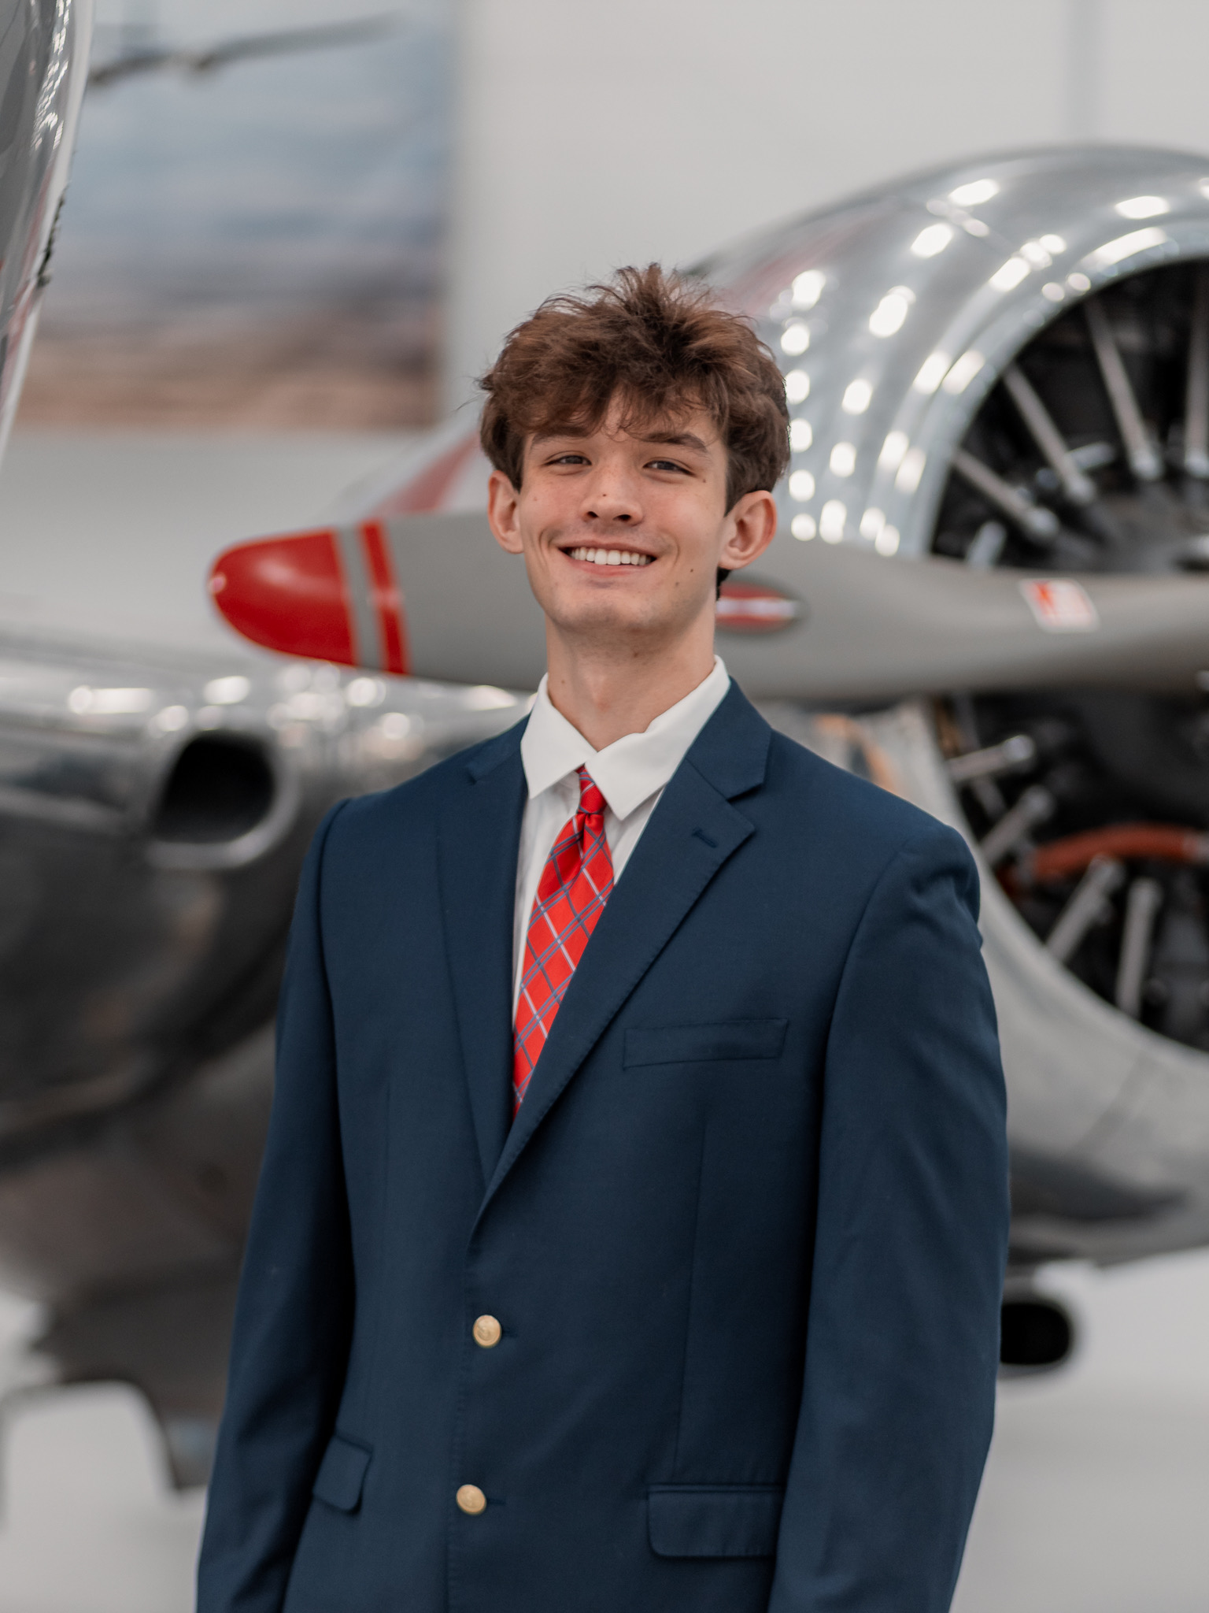
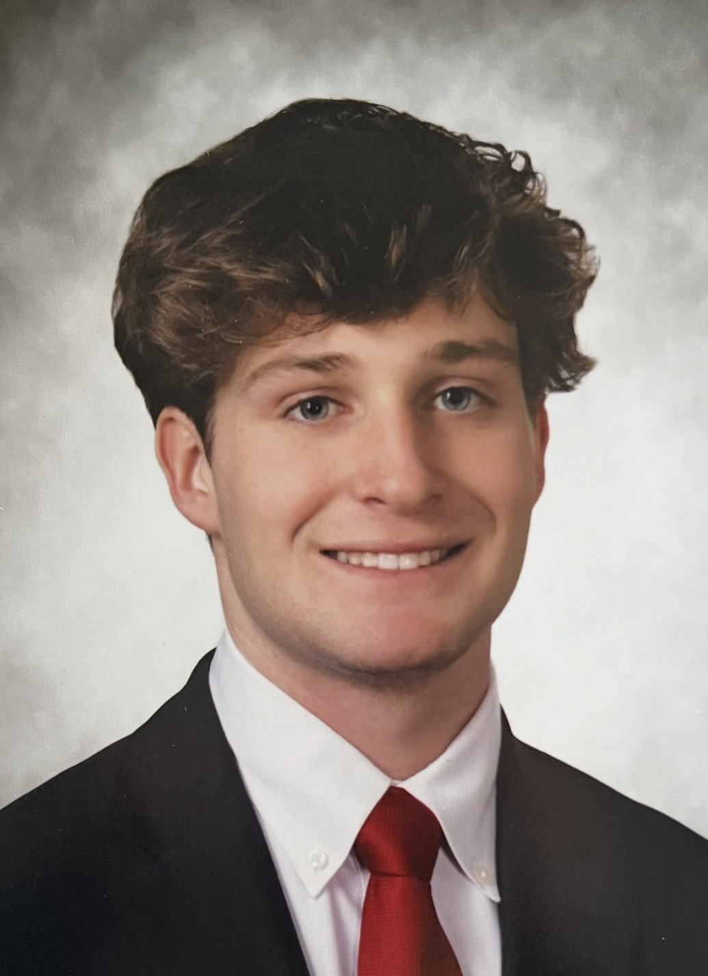

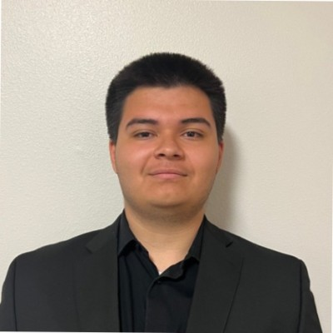
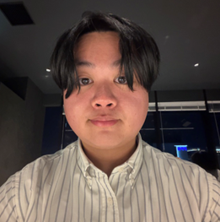
Our Team
Holden Crouse
Asher Tilghman
Andres Vasquez
Weijin Hsu
Luis Martinez

Slide 4

Project Overview
Sleep in Heavenly Peace (SHP), NRV Chapter
Reasoning for choosing SHP
  Providing relief to underprivileged children in the NRV
  Perspective: 23.8% of Montgomery County lives below the poverty line
  Proven reliability from sponsor
Main Deliverables
  Kickoff meeting held on Monday, Feb 9
  Deliverables are focused on assisting SHP create the most beds for children
Measuring Success
  Establish a meaningful relationship with the sponsor
  Create a positive impact on surrounding counties
  Help run a successful bed build (April 25th)
  Raise bedding for 40+ beds

Slide 5
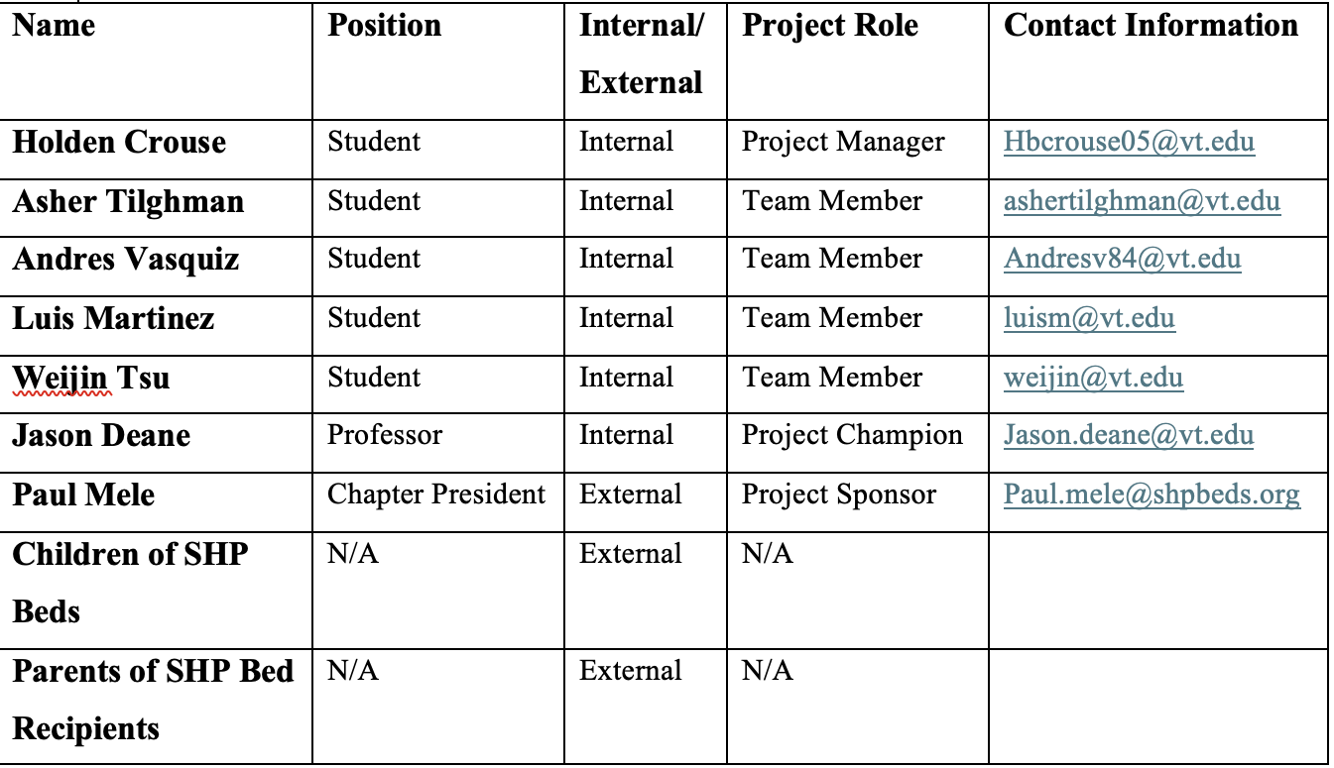
Stakeholder Register List

Slide 6
Questions, comments, or concerns?

